Slide 1
Lesson 4 Chapters 7-8
Tic-Tac-Toe Applet
Errors and Exceptions
UML

Slide 2
Handling Errors
Throwing and catching Execeptions

Slide 3
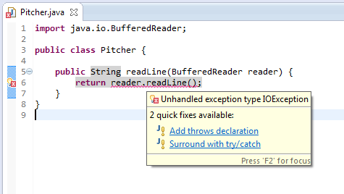
Try - Catch
Notes:
If you add a method call in your code to a method that throws an exception, the compiler will complain saying that there in an unhandled exception.
You can then decide to declare that your method throws the exception, or try to catch it.

Slide 4
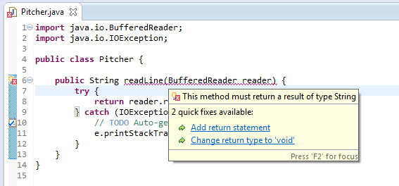
Try - Catch
Notes:
I chose to catch the exception, but the compiler is still not happy.
Now because I caught the exception, the method is no longer guaranteed to return a value.

Slide 5
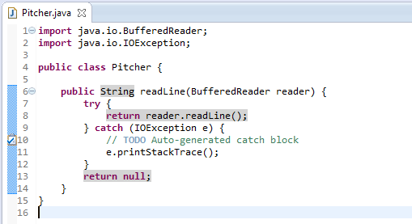
Try - Catch
Notes:
Now if there was an exception thrown, we will return null.
Notice the printStackTrace method. It will print out a stack of the previous method calls, so you can track where the error occurred.

Slide 6
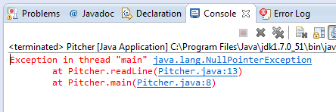
Stack Trace
Notes:
Read from the bottom. Click on any of the links to go to the line.
Notice that the NullPointerException is not an IOException.

Slide 7
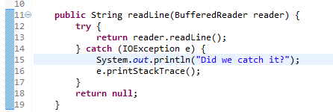
Stack Trace
Notes:
We can see that if we add the following line to our code, we don’t see that in the output. So we didn’t actually catch the exception.
That is because NullPointerException is not an IOException.

Slide 8
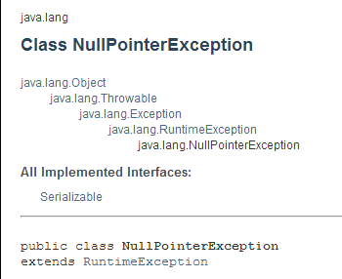
Runtime Exception
Notes:
This exception is a RuntimeException, and these do not need to be declared.
It still extends from Throwable, which means that we can catch it. Let’s “try”.

Slide 9
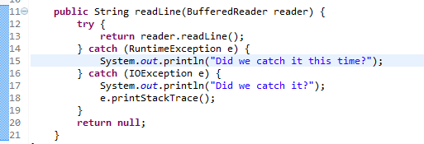
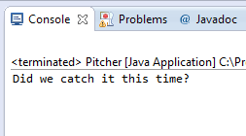
RuntimeException
Notes:
When an exception is thrown, the JVM goes through the catch clauses in order, so if one exception extends from another, that has to come first, otherwise the more general exception clause is always caught. Let’s try it.

Slide 10
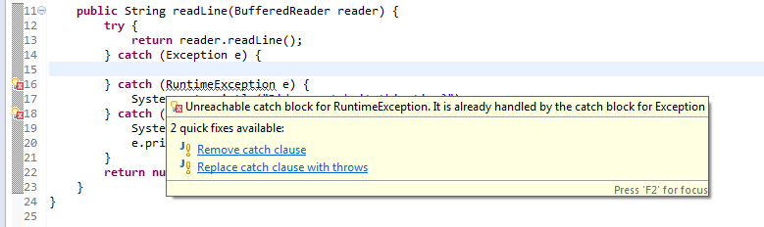
Catch order
Notes:
The compiler complains that we tried to catch the more general Exception first.

Slide 11
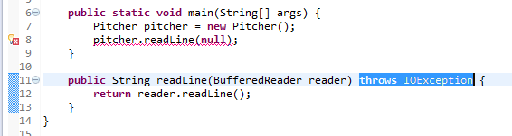
Throws
Notes:
We can choose to declare that our method throws IOException. In that case the problem is moved to the code that calls the method. We can see that now the compiler complains that the main method should catch the exception.

Slide 12
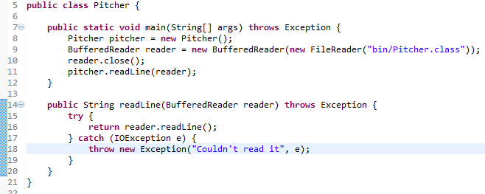
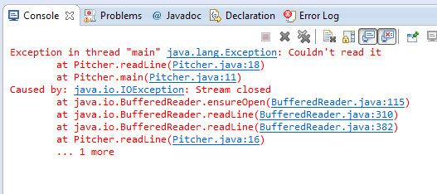
Throw
Notes:
Notice how we now throw a new exception in the catch clause.
We now see in the stack trace that there is a “Caused by:” statement. So we can see that we can add some more information to the stack trace that way.
That is the recommended practice if you declare throws, that you also catch the exception that caused it, and then re-throw it.

Slide 13
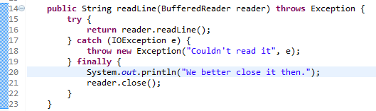
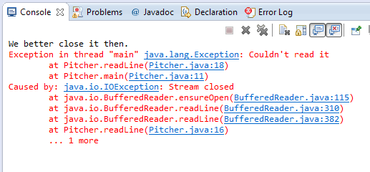
Finally
Notes:
Finally, you might want to always do something whether or not an exception was thrown. You put that in the finally clause. Beware that what you do here can also thrown an exception, maybe.
Notice how we got the finally clause executed.

Slide 14
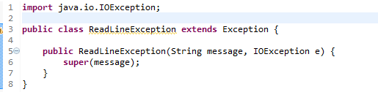
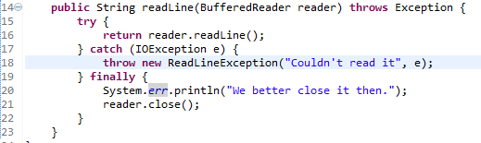
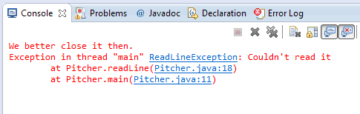
Create your own
Notes:
We created a new class ReadLineException that extends Exception.
We see in the stack trace that we get our own exception.

Slide 15
UML
Class Diagram

Slide 16
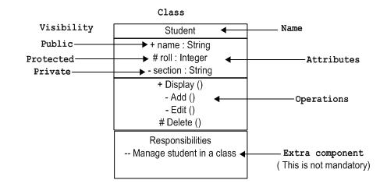
Class

Slide 17
Generalization – extends
Person
# name: String
A student has a name because
a student is a person
Student
- courses: Course[0..n]
A student attends a number of courses
Not every person does that
A student is a specific kind of person

Slide 18
Realization - Implements
<<Interface>>
Learner
+ learn(material: Material)
The line is dashed indicating
a weaker relationship.
A student is not only a learner
She is just able to learn
Intern
Student
One class can implement more than one interface

Slide 19
Association – Uses uni-directional
Course
Student
- students: Student[1..n]
The direction of the arrow indicates
who uses what.

Slide 20
Association - Uses bi-directional
If both classes uses each other
there is no arrow.
Teacher
1..n
1..200
Student
- students: Student[0..n]
- teachers: Teacher
1..10
Course
Cardinality

Slide 21
Association - Knows uni-directional
The book doesn’t know about
the student
Student
Book
- books: Book[0..n]
The line is dashed indicating a
weaker relationship

Slide 22
Association - Aggregation
Here uni-directional because the pages don’t know about the book.
Book
1..1000
Page
# pages: Page[1..1000]
The pages are part of the book
You would say that a book aggregates
pages.

